Slide 1
1 Planed
Planed 1
Week11-week12
4

Slide 2
1 Results
Results 1
Finish the week11
I find that I forget the rest of assignment4, I will finish it next week.
4

Slide 3
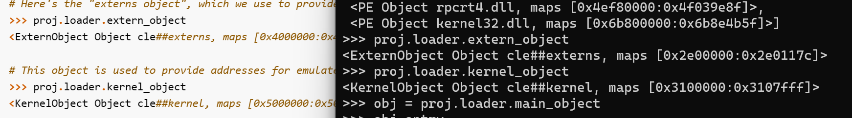


1 Challenges and Solutions
Challenges and solutions 1
What is the extern object? What is the extern object used for?
4

Slide 4
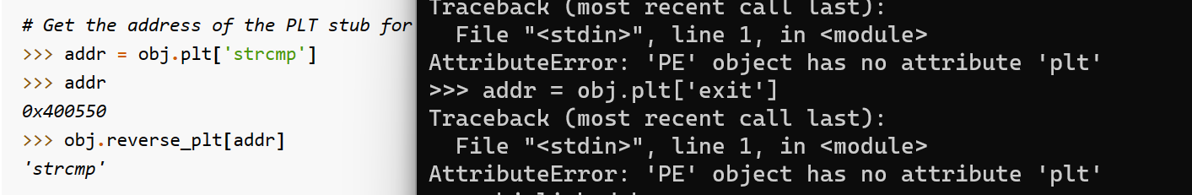
1 Challenges and Solutions
Challenges and solutions 1
‘plt’ and ‘reverse_plt’ are used in ELF object, but not PE.
So I can use ‘obj.imports’ to get the information of imported functions. But there is no packaged method to get a function address by its name in ‘PE’ object ?
4

Slide 5
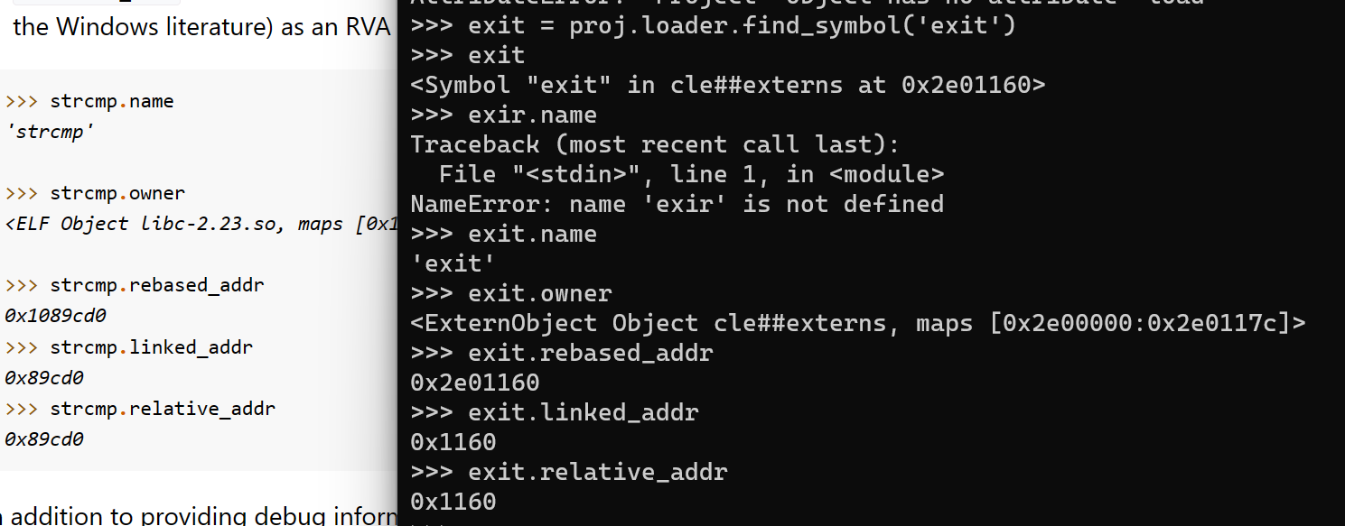


1 Challenges and Solutions
Challenges and solutions 1
What is the difference between linked_addr and relative_addr? The value of them is the same.
4

Slide 6
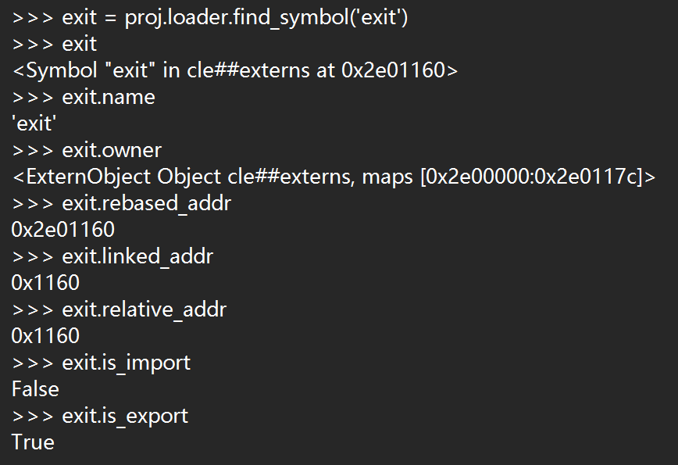
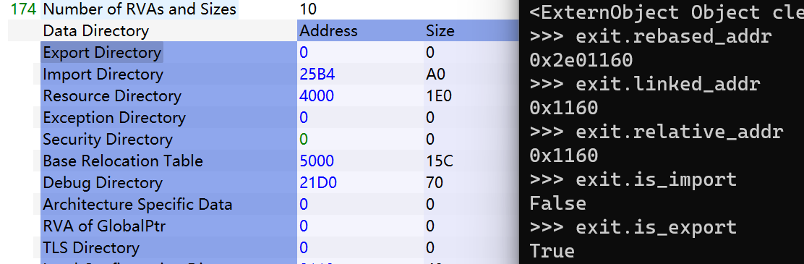
1 Challenges and Solutions
Challenges and solutions 1
The function ‘exit’ is a export function? Why?
I use PE-bear to analyses a executable file and find that it doesn’t have export directory.
4

Slide 7
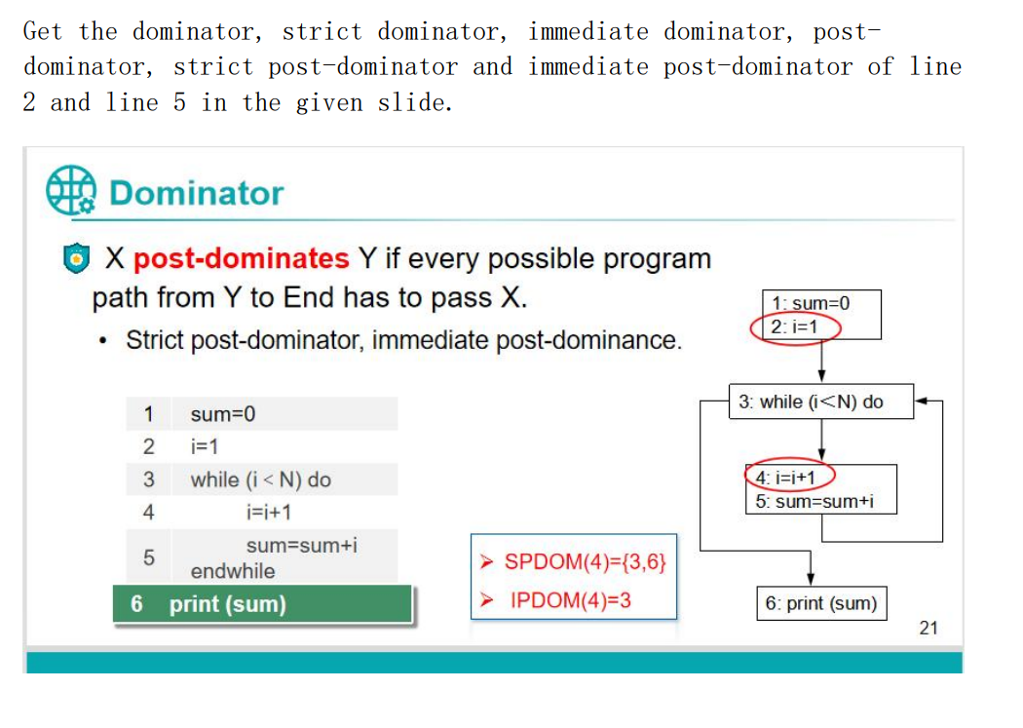
Assignment5
SDOM(2) = 1
SDOM(5) = {1,3,4}
IDOM(2) = 1
IDOM(5) = 3
PDOM(2) = {3,6}
PDOM(5) = {3,6}
SPDOM(2) = {3,6}
SPDOM(5) = {3,6}
IPDOM(2) = 3
IPDOM(5) = 3
4

Slide 8
1 Plan
plan 1
Finish the study of angr and WinDbg(week12-week13) next week.
Do the assignment6 next week.
“””
factory
“””
block = proj.factory.block(proj.entry)
print(block.pp())
print(block.instructions)
print(block.instruction_addrs)
print(block.size)
block.capstone.pp()
block.vex.pp()
4

